Slide 1



The Soccer League
TO BE VIEWED IN SLIDESHOW MODE
A GAMIFIED APPROACH TO IMPROVE
NET PROMOTER SCORE (NPS)

Slide 2
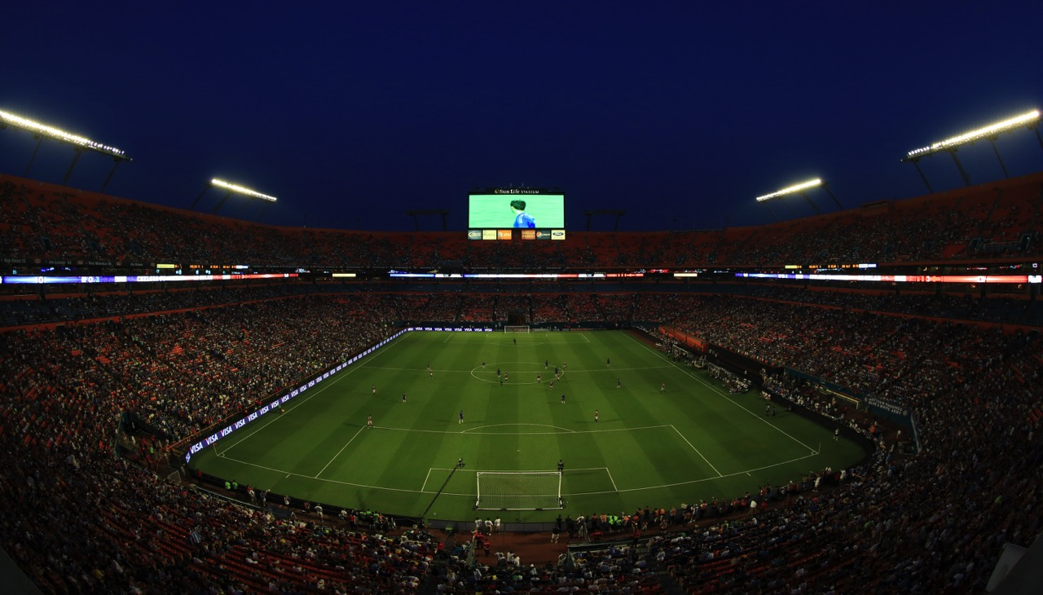

Objective
Objective
The objective of the Soccer League is to improve the performance on the target metric - NPS (Net Promoter Score)
Calculation
NPS
The Net Promoter Score is calculated by subtracting the percentage of customers who are Detractors from the percentage of customers who are Promoters.
NPS Measures customer Loyalty
Rating
Survey
The scoring is most often based on a 0 to 10 scale. Promoters are those who rate the service 9,10; customers who rate 7,8 are considered passive, and customers who rate 0,1,2,3,4,5 and 6 are considered detractors.
The Net Promoter Score is calculated based on responses to a single question: “How likely is it that you would recommend our company/product/service to a friend or colleague?”

Slide 3
The Engagement Roadmap
The following slides would focus on the Stage 2 - Gamification aspect of the Soccer League
The Soccer League would use a combined approach to improve the NPS Metric as shown below:
Stage 1
Participants will attend a one day classroom training program, designed to educate the learners about techniques to improve Customer Engagement
The training program will contain customer-experience case-studies from other related industries
Stage 2
Implementation of the Soccer League Championship
Teams play the matches and proceed to the advanced rounds based on performance
A web-based dashboard is deployed to track the progress of the matches

Slide 4
Potential Benefits of the Soccer League
The Soccer League can successfully integrate game mechanics with technology to produce powerful results
The OnTrac platform, in conjunction with technologies such as Mobile Apps and WhatsApp, can further enhance the performance on the target metrics
The League Cup will help create a healthy competition on the floor between teams.
The design of the League Cup framework ensures that learning from the classroom is actively translated into actionables on the floor, resulting in creation of sustainable behavioural habits.
The universal appeal of football combined with technology makes the Soccer League Framework easily scalable to other geographies and processes.
In the end, while the best team gets to lift the Soccer League Championship Trophy, the true winners will be the Customers.

Slide 5
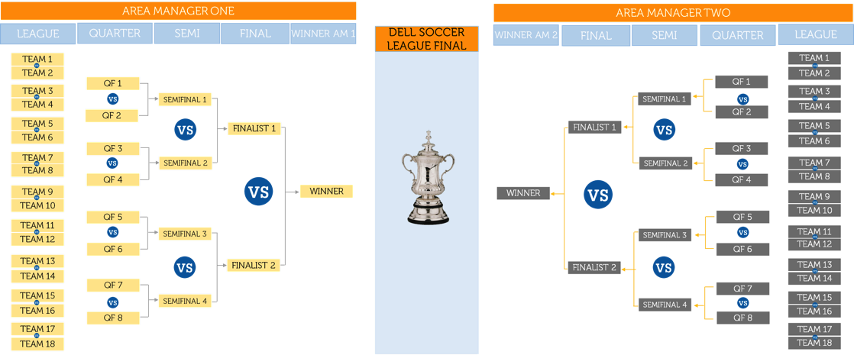
The Game Plan
The Tournament can be custom designed. For example, there could be a playoff between two divisions. Or it could be a single division tournament.
DIVISION A
DIVISION B
SOCCER LEAGUE FINAL

Slide 6
The Game Plan – Points Table
POSITION | TEAM NAME | CAPTAIN | PASSES | GOALS | NET SCORE | POINTS
1 | ARGENTINA | JULIO | 22 | 20 | 0.90 | 9
2 | GERMANY | MICHAEL | 24 | 21 | 0.85 | 8
3 | ENGLAND | JOHN | 14 | 10 | 0.71 | 6
4 | INDIA | RAMESH | 35 | 24 | 0.68 | 6
5 | COLOMBIA | ROMEIRO | 21 | 12 | 0.57 | 3
6 | SOUTH KOREA | JOO WON | 35 | 17 | 0.48 | 2
Position = The team ranking
Team Name = The unique name given for each team under a team leader (e.g. country or club)
Captain = The Team Leader for the team
Passes = Number of Quality Audits Completed for the team member
Goals = Number of Positive Customer Experiences delivered (as marked by the QA)
Net Score = Goals divided by Passes
Points = Each Team wins points based on their performance in individual matches
a. Win = 3 Points
b. Draw = 1 Point
c. Red Card = (-1) Point (Any Compliance breach on the audited call)

Slide 7
The Game Plan – Ally League
POSITION | TEAM NAME | CAPTAIN | PASSES | GOALS | NET SCORE | POINTS
1 | RUSSIA | BORIS | 23 | 19 | 0.82 | 4
2 | FRANCE | COUSTEAU | 25 | 18 | 0.72 | 3
3 | USA | JACK | 16 | 11 | 0.68 | 3
4 | UAE | SHAFIR | 33 | 21 | 0.63 | 2
5 | CAMEROON | CEDRIC | 20 | 12 | 0.60 | 2
6 | SOUTH AFRICA | BASOTHO | 35 | 16 | 0.45 | 1
The Ally League round starts after the First Round (League) of matches are over.
The teams that do not qualify to the Quarter Final, and the subsequent rounds, are added to the Ally League.
Here, the top three teams that finish at the top of the Ally League Points Table based on Net Score will be selected for the Ally League Rewards.

Slide 8
Soccer League – Key Action Points
Classroom Training
Participants to undergo an 8-hour classroom session
The classroom session includes samples of calls that demonstrate the desired behaviour
The classroom session also includes samples of calls where the desired behaviour could have been demonstrated
The quality team to be sensitized about the Soccer League Game Plan
All members in the Quality Team to be calibrated on the scoring methodology
The top performing teams and team members to be recognized and rewarded with a pre-defined frequency
The team that wins the Finals to be awarded the Soccer League Championship Trophy
Championship Trophy
Quality Calibration
The leadership team to commit full support to the Soccer League
The Leadership Team to support the Game Plan through R&R for the top performing Individuals and Teams
The Quality Team to monitor the calls and provide OnTrac with the scores for each week
OnTrac to use these scores to publish the weekly game dashboard
An interactive and graphically-rich web-based platform to be made available for the participants to keep updated about their performance
OnTrac to publish a weekly snapshot report showcasing each team member’s/team’s ranking
The
Soccer League
Quality Monitoring
Leadership Support
Visual Dashboard

Slide 9
Infrastructure Requirements
Client to provide the headcount list for the Teams
Ensuring Soccer League website (hosted by OnTrac) can be accessed by the Team Leads and team members from workplace
Display rich dashboards from website on floor through wide screen TVs if possible.
Employee details such as hobby, photographs to create profile pages on the game website
Standees and posters to create awareness on the floor
Budgets for awards (several midcourse awards and final awards) to be decided
Pre-launch event to be conducted on the floor in the presence of senior leaders
A mechanism to ensure The Soccer League Quality Audit data (Passes and Goals) is shared with OnTrac on a weekly basis.

Slide 10
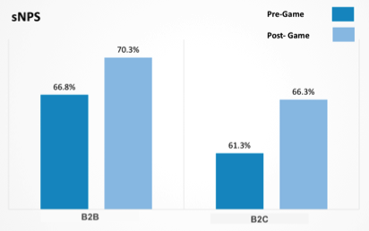
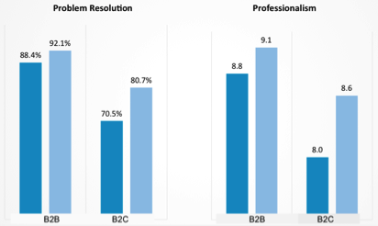



THE FEFA CUP – SUCCESS STORY
CASE STUDY ON USE OF GAMIFICATION (HEWLETT PACKARD)
Requirement: The client, Hewlett Packard, wanted to improve its issue resolution percentage and consequently, its Net Promoter Score. While its engineers were experts, there was scope to perform better on certain types of customer problems, on both their B2C and B2B businesses.
Solution: OnTrac created a combination of training and knowledge implementation through its Dri.Ve gamification platform. Over 1500 engineers were trained on resolving specific types of issues through a program that involved demonstrations of techniques, followed by a 2 month game on the floor. The game transformed the entire operations floor into a FIFA Styled football (soccer) tournament. Every team leader and his team represented a country. Their objective was to score as many goals as possible, by demonstrating the skills gained in the training program. We worked with the client's quality team to capture the relevant scores that helped calculate the goals scored.
Result: The game had a transformative effect on the operations floor and the initiative was a grand success. Both issue resolution and NPS went up significantly. Customers also rated the engineers higher on Professionalism. The client was very happy with the results and has decided to roll out the game its centers in other cities and countries. See the charts for the improvements seen by our client.
HP Won an Industry Award for this performance

Slide 11
DRI.VE PLATFORM PREVIEW
An OnTrac Platform
TO BE VIEWED IN SLIDESHOW MODE

Slide 12
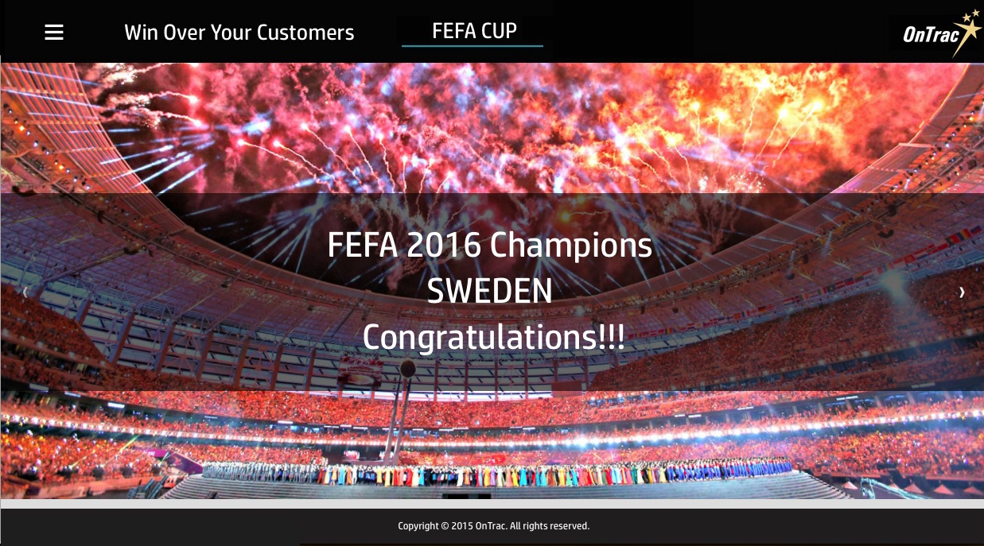

Slide 13
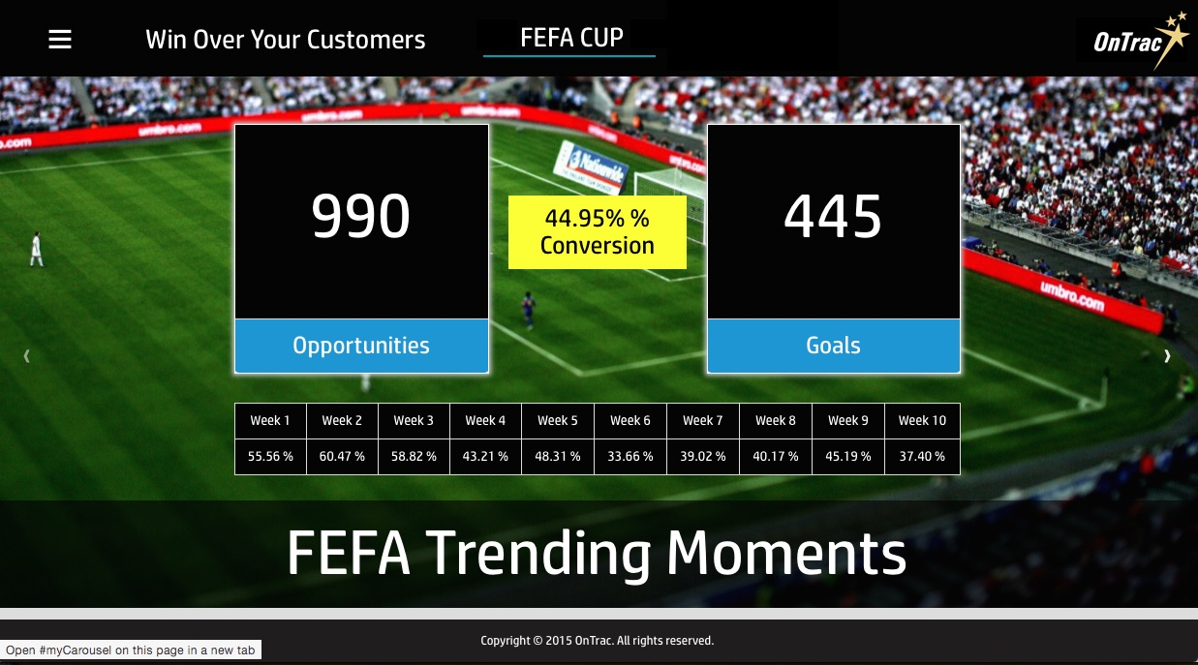

Slide 14
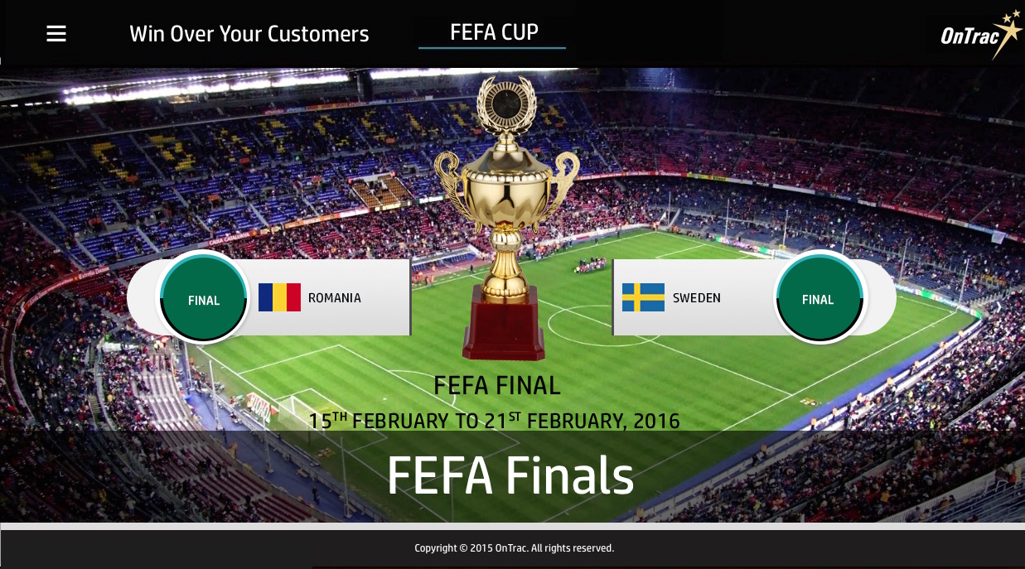

Slide 15
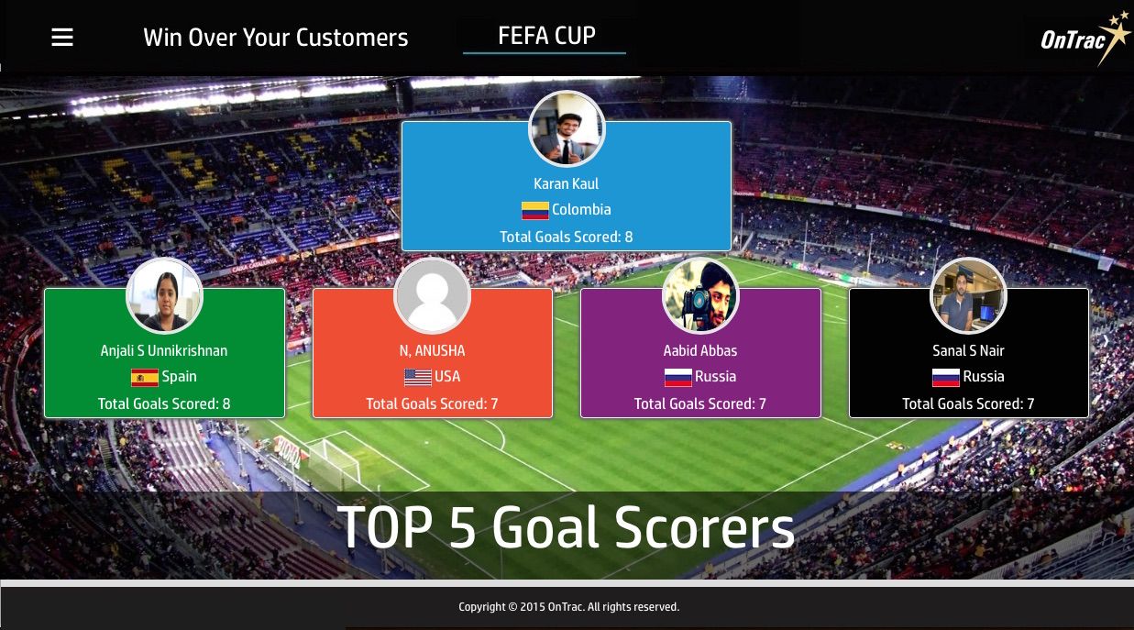

Slide 16
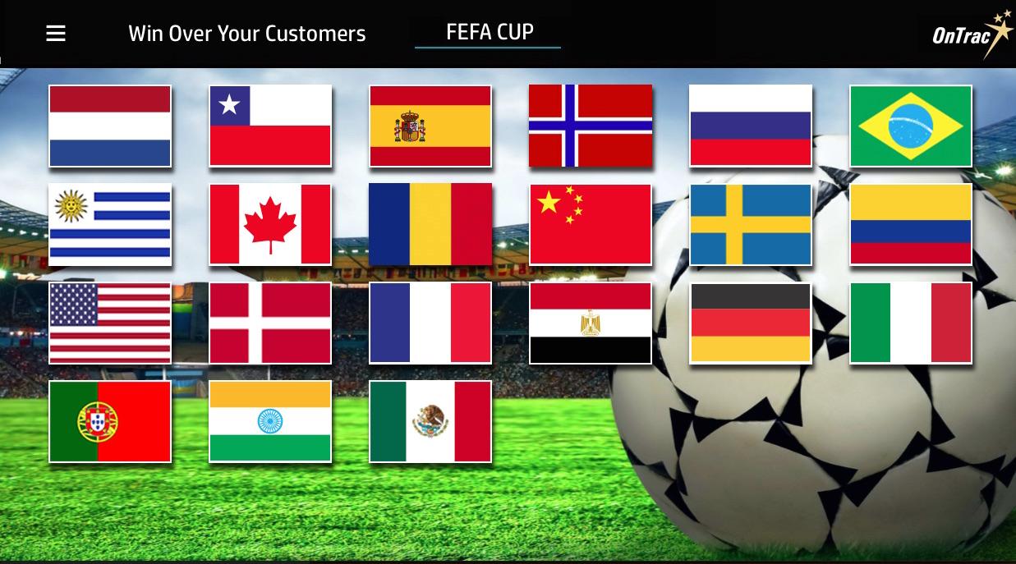

Slide 17
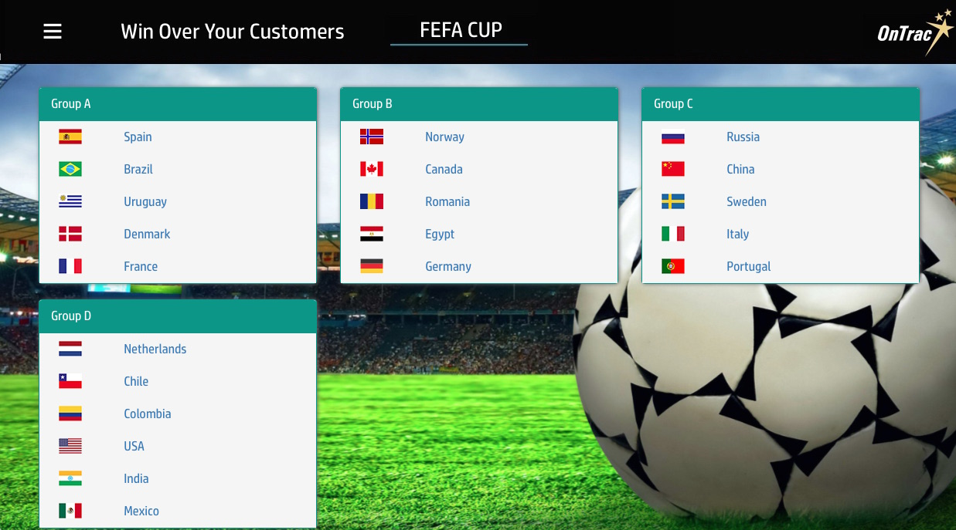

Slide 18
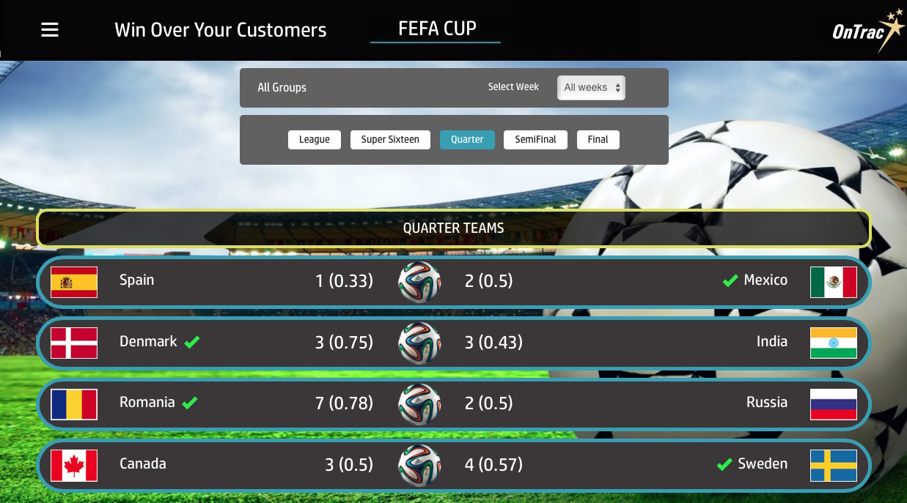

Slide 19
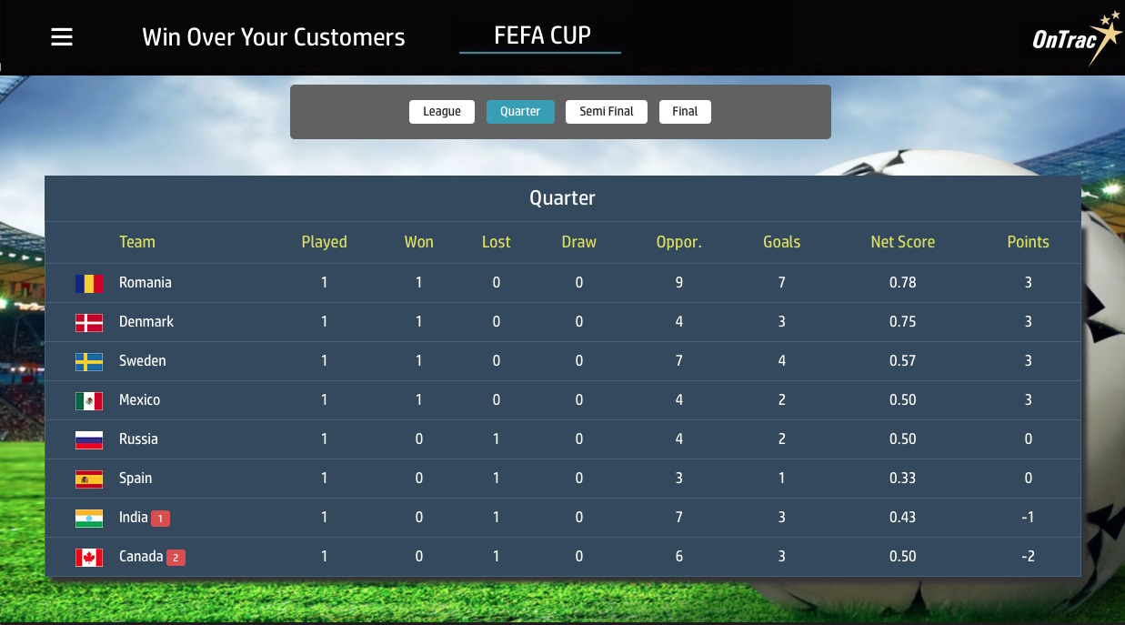

Slide 20

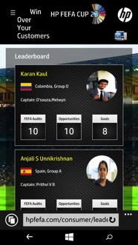
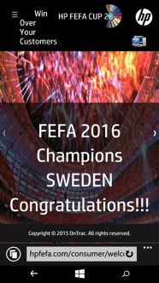
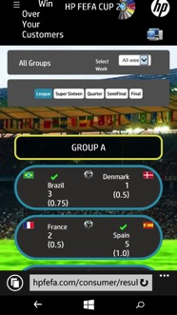
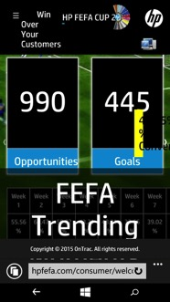
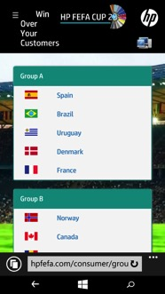
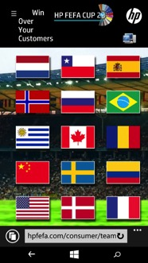
Mobile Enabled

Slide 21
EXCITEMENT ON THE FLOOR
TO BE VIEWED IN SLIDESHOW MODE

Slide 22
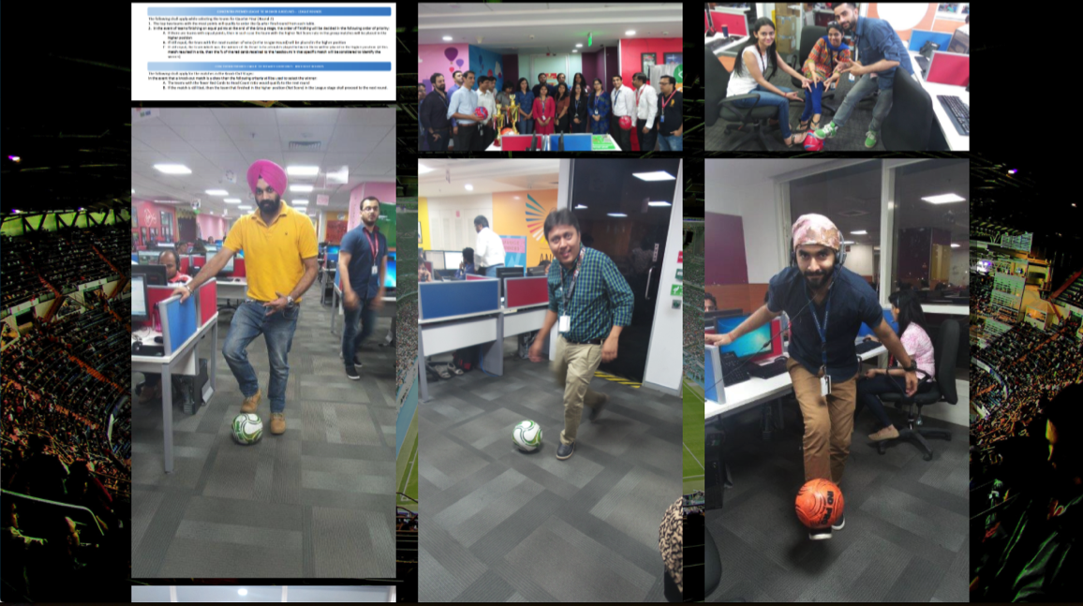

Slide 23
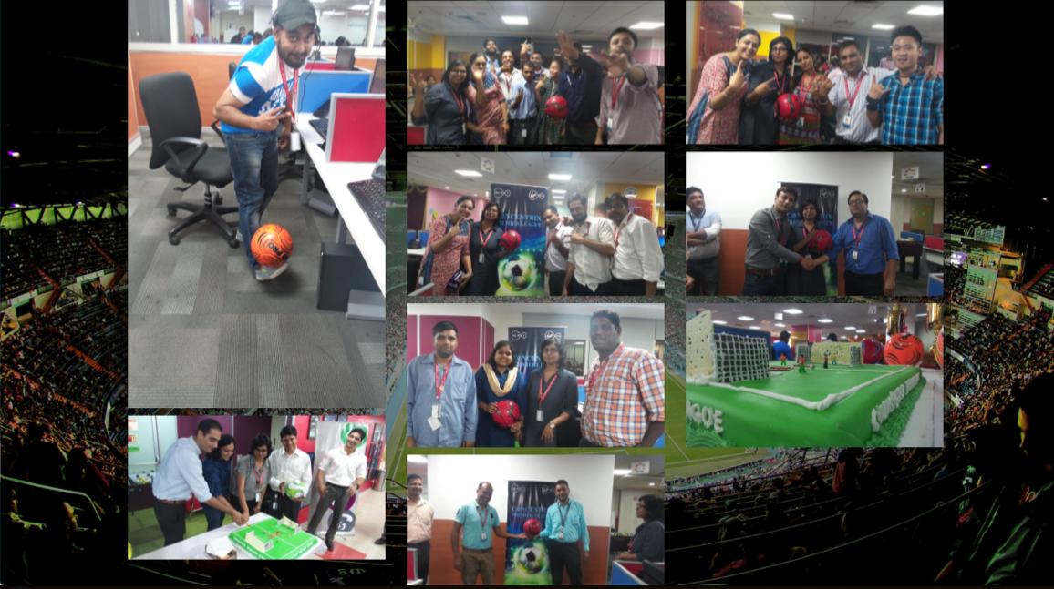

Slide 24
END… Contact info@iamontrac.com

