Slide 1

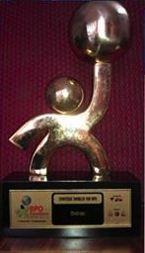
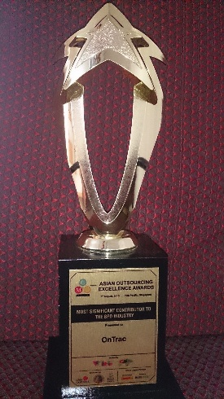
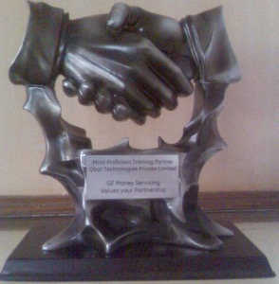
OnTrac Training Programs
Leadership and People Development
Professional Development
Customer Relationship Management
DiSC® Series

Slide 2




About Us
01
Operations Management Training
We provide training for a variety of companies to help improve people capabilities and operational efficiencies
02
100/100
100+ top tier clients, 100% client referral rate, Global delivery capabilities
03
Awards
Best Vendor partner from Accenture 2015
Most Significant Contributor to Industry at Asia Outsourcing Excellence Awards in Singapore 2013
ATD (formerly ASTD) Citation
And many more…
OnTrac was founded by Ravi Venkatesam, an IIT / IIM Alumnus. Ravi’s experience has spanned across multiple industries over the last 25 years. However, his passion for learning and development has led him to create OnTrac in 2004 and “The Foundation School”, a chain of K12 schools in Bangalore.

Slide 3
Our Training Programs
We conduct trainings programs in 4 areas. Programs in each of these areas can be customized as required.
LEADERSHIP AND PEOPLE DEVELOPMENT SERIES
PROFESSIONAL SKILLS SERIES
INSCAPE DISC® SERIES
CUSTOMER MANAGEMENT SERIES

Slide 4

Leadership and People Development Series
 | Entry Level Staff | Team Leaders | Mid Level Managers | Senior Leaders
Situational Leadership
Executive Presence
Coaching Skills (Grow Model, AICR Model)
Feedback Skills (Giving and Receiving)
People Development
Negotiation Skills
Conflict Management
Change Management
Motivational Skills
Performance Appraisals
Delegation
Stress Management
Launchpad (Role effectiveness, team dynamics, communication, influencing/persuasion)

Slide 5

Professional Development Series
 | Entry Level Staff | Team Leaders | Mid Level Managers | Senior Leaders
Decision Making Skills
Creating an Execution Culture
Problem Solving Skills
Presentation Skills
Interviewing Skills
Planning and Prioritization (Time Management)
E-Communication (Email, Social Media, Text and Chat)
Basic/Advanced Excel Skills
Facilitation Skills
Performance Appraisals
Stress Management
Analytical Skills

Slide 6

Customer Management Series
 | Entry Level Staff | Team Leaders | Mid Level Managers | Senior Leaders
Client Centricity
Customer Relationship Management
Preparing for Client Reviews
Customer Service Skills (Physical Interactions)
Customer Service Skills (Contact Center)
Voice and Accent Training (Contact Center)
Handling Customer Complaints

Slide 7

Inscape DiSC® Series
 | Entry Level Staff | Team Leaders | Mid Level Managers | Senior Leaders
DiSC® Communication
DiSC® Conflict Management
DiSC® Team Management
DiSC® Profile and Interpretation
DiSC® Sales

Slide 8
Our Facilitators
OnTrac’s facilitators are carefully selected based on three parameters.
EXPERIENCE
EXPERTISE
Depending upon the audience, we select and deploy trainers with the right amount of industry experience. For example, if the target audience is senior management, then the facilitator should have directly or indirectly managed such an audience, or, should have worked in their industry/domain.
Industry experience overlaid with training expertise is a potent combination that we look for. All our facilitators have expertise in areas such as classroom training, content development, assessments, instructional design etc. We believe that experience does not necessarily create expertise and therefore, we deliberately look for this quality in our facilitators.
INDUSTRY
EXPERIENCE
TRAINING
EXPERTISE
ONTRAC
FACILITATORS
TRACK RECORD
TRACK RECORD
On top of experience and expertise, we also look for the facilitator’s track record. We ensure that our facilitators have a meticulous track record of their training programs. After every training program, feedback is given and discussed.

Slide 9
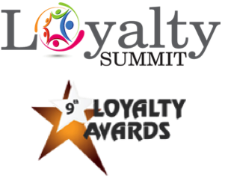

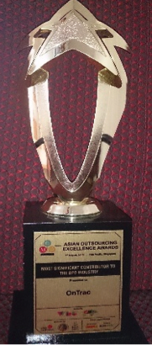
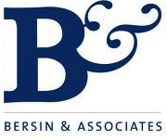
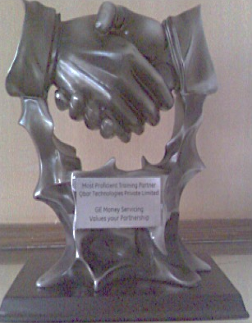
Awards and Recognitions
Our work has received awards both for us as well as our clients. Here are some of them.
Accenture
Hewlett Packard
ATD USA, Citation
Our training gamification platform and methodology helped HP improve customer satisfaction and win the “Best use of Gamification to Enhance Loyalty” award in the Loyalty Summit 2015.
Our project received a citation from ATD, US (formerly ASTD) in the Integrated Talent Management
We received best the Gold Award in Feb 2016 for being Accenture’s best vendor partner.
category, for the work we did on developing the client’s top talent pipeline.
Asia Outsourcing Awards, Singapore
We received an award at the Asia Outsourcing Awards forum in Singapore for excellence in training
Bersin, USA Award
Our client won the Learning Leader award for Operational Training and
GE Money
We received the Most Proficient Partner award from GE Money for our excellence in training and development
development Excellence in recruitment capability.

Slide 10
Sample of Large Assignments (Partial List)
We have worked with our clients where we have run multiple long term assignments for them. Some examples are:
Accenture
Multiple enterprisewide contracts ranging from 1 to 3 years
Conducting programs for multiple levels ranging from skills set 1 (entry level) to skills set 4 (Sr. Management level)
Courses include programs such as Presentation Dynamics, First Things First, Leadership Conversations, Situational Leadership, Achieving Meeting Results etc.
Helped build and conduct operations management programs such as Academy of Leadership Excellence and Leadership Excellence Program (currently ongoing - multi year initiative)
Currently helping build multi year program for top talent. To be deployed later in the year.
Cognizant
Annual contracts renewed every year for multiple types of programs
Conducting programs for entry level employees, team leaders and managers
Courses include programs Star Certification Program (Operations and people management for first time managers), Communication Skills, Stake holder management etc.
Worked with client to create training strategy for new deal
Vision Express
Training Store Personnel at multiple cities in India
Identified and vetted multiple trainers in many tier 2 and tier 3 cities for training
Conducted training programs on customer service skills and product knowledge.
Training rolled out in 9 states (Andhra Pradesh, Delhi, Karnataka, Maharashtra, Tamil Nadu, Punjab, Gujarat, Rajasthan and West Bengal.
Total number of stores covered was 69 across all these states.
Hindustan Petroleum
Training on Collaborative Partnerships and Synergistic Teamwork
Program conducted for mid and senior level executives
Program based on DiSC® framework
Themes covered in the program were Networking, Influencing, Internal and External relationship management, Driving team accountability, Performance orientation and culture.
Jetking Training Institute
Trained franchisees and their employees on various aspects of customer service to improve conversion rates of walk-ins, pan India.
HSBC
Conducted behavioural skills and operations skills Program for the Assistant Manager (Operations) across 5 countries including India, Philippines, China, Malaysia and Sri Lanka.

Slide 11
END
Contact info@iamontrac.com

